Slide 1
CNT4007C: Theory and Fundamentals of Computer Networks
Data Link Layer
Content derived from various sources including Tomsho et al., Guide to Networking Essentials,
Kurose and Ross, Computer Networking: A Top-Down Approach

Slide 2
Overview of Data Link Layer I
Introduction and services
implementation & adapters
Error detection and correction
Multiple access protocol
Ethernet Frame Structure
Address Resolution Protocol (not quite at Data Link Layer)

Slide 3
Background on Data Link Layer
Sits on top of the physical layer in the OSI reference model.
Breaks user data from a higher layer into data frames and transmits them sequentially over the physical layer’s communication channel.
Ensures that data are correctly transmitted
detects transmission errors
detects loss of data packages
Has built-in traffic regulation mechanisms to let transmitter know when data arrive too fast (flow control).

Slide 4
Data Link Layer in OSI Reference Model
Host A
Host B
Framing,
Error detection,
Flow control
Virtual data path
Data Link Layer
Encoding
Physical Layer
Actual data path

Slide 5

Data Encapsulation in OSI Reference Model
source
message
M
application
transport
network
link
physical
segment
H_{t}
M
H_{t}
datagram
H_{n}
H_{n}
H_{t}
M
frame
H_{l}
H_{n}
H_{t}
M
link
physical
switch
destination
M
application
transport
network
link
physical
H_{n}
H_{t}
M
network
link
physical
H_{t}
M
H_{l}
H_{n}
H_{t}
M
H_{n}
H_{t}
M
H_{n}
H_{t}
M
H_{l}
H_{n}
H_{t}
M
router

Slide 6

Link Layer Services
Framing and network access
encapsulating data into frame, adding header and footer
addressing frame using the MAC address
accessing communication channel
Reliable deliver between adjacent nodes
seldom used on low bit-error link (fiber, some twisted pair)
wireless links: high error rates
“adjacent” nodes in LAN
Host A
Host B
generates a frame
LAN
11000110101000101011

Slide 7
Link Layer Services (cont.)
Flow Control
adjusting data flow between adjacent nodes in network
Error Detection
errors may be caused by signal attenuation, noise, etc.
receiver detects presence of errors in frame
receiver may request new transmission of erroneous frames
Error Correction
receiver detects bit error in frame and repairs the frame
Half-duplex, Full-duplex
two nodes in a ongoing communication may send at same time (full-duplex) or one at a time (half-duplex)

Slide 8
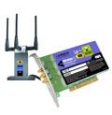
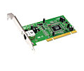
Where is the link layer implemented?
In each and every host!
link layer implemented in Network Interface Card (NIC)
Ethernet card, PCMCI card, 802.11 card
implements link, physical layer
NIC attaches into host’s system buses.
Combination of hardware, software, firmware.
host schematic
application
transport
network
link
cpu
memory
link
physical
host
bus
(e.g., PCI)
controller
physical
transmission
network adapter
card

Slide 9
Adaptors Communicating
datagram
datagram
controller
controller
sending host
receiving host
datagram
frame
sending side:
encapsulates datagram in frame
adds error checking bits, rdt, flow control, etc.
receiving side
looks for errors, rdt, flow control, etc
extracts datagram, passes to upper layer at receiving side

Slide 10
Error Detection Protocol and Reliable Service

Slide 11
Error Detection / Correction Overview
Errors may occur when transferring data between neighboring nodes in a local network.
Error detection identifies an error but cannot repair it.
not 100% reliable
Error correction identifies an error and detects it.
error correction is limited
datagram
y
all bits
in frame ok?
N
datagram
detected error
frame
EDC’
frame’
EDC’
bit-error prone link between neighboring nodes

Slide 12
Error Detection using CRC (Illustration)
Message (M)
Divide by CRC Polynomial C(x)
Remainder (R)
Concatenate
Transmit over network
Divide by CRC Polynomial C(x)
Remainder = 0 ?
Strip off Remainder
No
Discard Frame
Original Message (M)

Slide 13
Reliable Transmission in Data Link Layer
Lost or damaged frames must be handled to ensure reliable transmission.
Typically accomplished through retransmissions
It is possible to encode sufficient information in a frame to actually recover from damaged data (using ECCs - Error Correction Codes)
However, approaches can only handle limited ranges of errors
Easier to throw the frame away and transfer the frame again
Relies on two basic mechanisms
Acknowledgments (ACKs)
A small control frame that notifies the other end about frames received
Timeouts
A mechanism that allows the sender or receiver to wait for a specified amount of time and then take corrective action if the awaited event does not occur.
Also known as Automatic Repeat Request (ARQ).

Slide 14
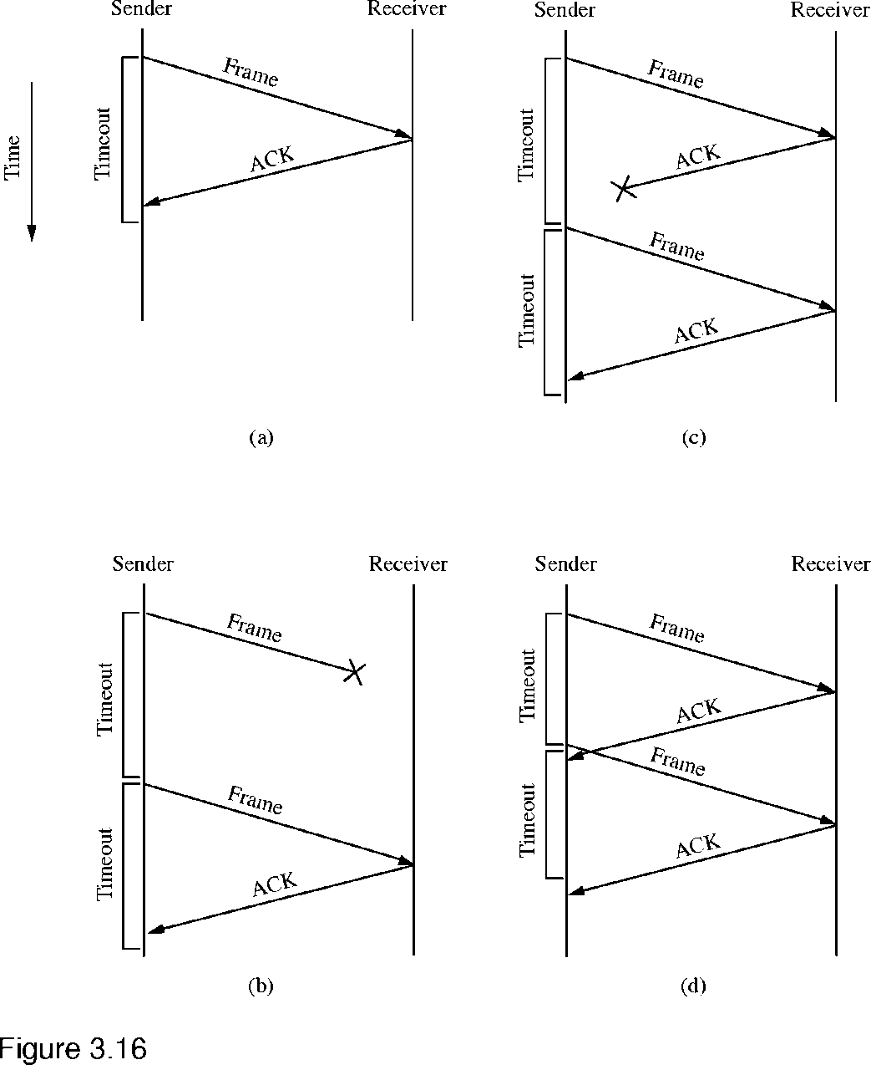
Reliable Transmission – Stop & Wait
Simple scheme
After each frame is transmitted, wait for an ACK from the recipient
If no ACK is received within some timeout period, assume the frame is lost and retransmit
Four possible scenarios:
ACK is received normally
Original frame is lost
ACK is lost
ACK is received too late

Slide 15
Media Access Protocol

Slide 16
Mulitple Access Protocol Overview
Types of links:
Point-to-Point (PPP)
broadcast
Point-to-Point
original dial-up (PPP)
over Ethernet (PPPoE)
segment link between host and switch
router-to-router
Broadcast (shared wired or wireless medium)
old-fashioned Ethernet
wireless LAN (803.11, RF)

Slide 17
Multiple Access Protocol Overview (cont.)
Shared Broadcast Channel:
multiple nodes may access simultaneously channel for transmission
Solution:
time- or frequency-division multiplexing
distributed / centralized system that determines when node can transmit
requires channel for coordination

Slide 18
Multiple Access Protocol Taxonomy
Over shared media:
Channel partitioning
divide channel based on time slots, frequency, etc.
each node is given a designated slot, frequency, etc.
Random Access
channel may be accessed at any time by node
may cause collisions that must be addressed
Taking Turns
nodes take turns to access shared media

Slide 19
Channel Partition Example
Example:
FDM
4 users
frequency
time
TDM
frequency
time

Slide 20
Link Layer Protocols: Random Access Protocols
When network nodes have data to send:
nodes transmit at full channel data rate
no coordination among nodes on who sends first
When network nodes transmit collision may happen.
requires technology to detect collisions
requires protocol to address collisions and recover from them
Random Access MAC Protocol
Examples include:
(slotted) ALOHA
CSMA, CSMA/CD, CSMA/CA

Slide 21
Slotted ALOHA
node 1
1
1
1
1
node 2
2
2
2
node 3
3
3
3
slots
C
E
S
C
S
E
E
C
E
all frames are of same size
time is divided into equal size slots
a time slot permits a node to send a frame
nodes are synchronized
nodes start transmitting at slot beginning
if 2 or more nodes transmit in a slot, all nodes detect collision
when node obtains fresh frame, it transmits the frame in next slot
if no collision: node successfully transmitted frame,
if collision: node must retransmit frame in each subsequent slot with probability p until success

Slide 22
Carrier Sense Multiple Access/Collision Detection (CSMA/CD)
Used by Ethernets to send frames.
Step 1: Listen on the network before transmitting.
Step 2:
If no signal detected (channel is idle), transmit frame.
If signal detected (channel is busy), wait.
Step 3: After frame has been transmitted, check if a collision occurred.
If no collision detected, frame was successfully transmitted.
If collision has been detected, wait some time before retransmitting.

Slide 23

CSMA/CD (Illustration)
listening host
sending host
listening host
No Collision!
listening host
listening host
sending host
listening host
sending host
Collision!
listening host
listening host

Slide 24
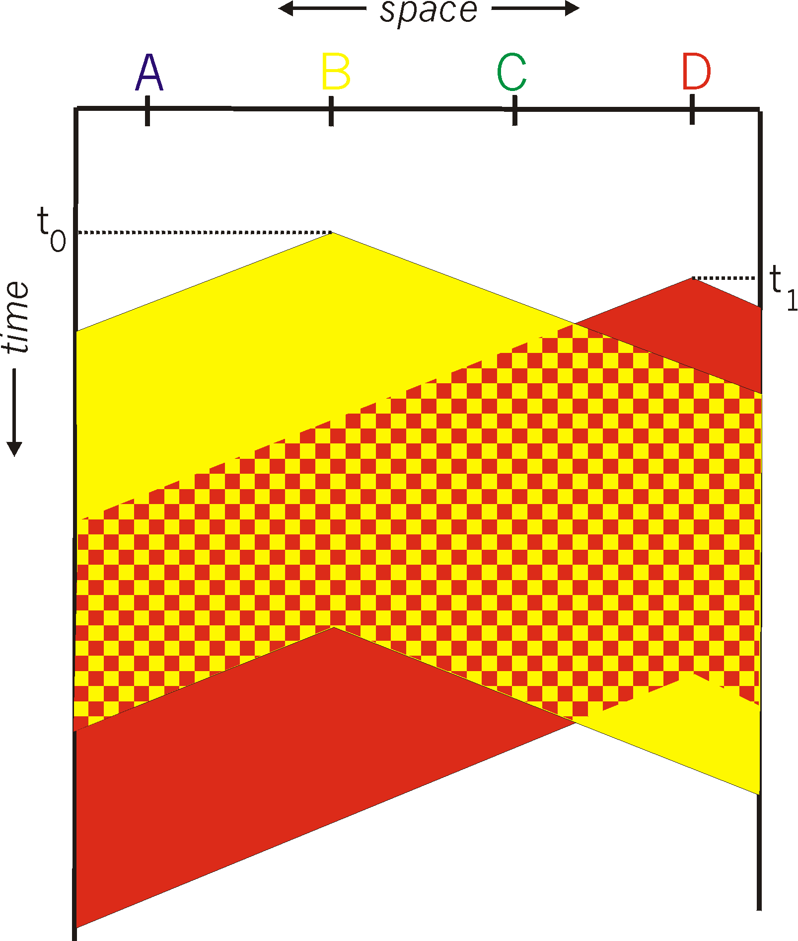

CSMA collisions
spatial layout of nodes
collisions can still occur: propagation delay means two nodes may not hear each other’s transmission
collision: entire packet transmission time wasted
distance & propagation delay play role in in determining collision probability

Slide 25
CSMA/CD (collision detection)
CSMA/CD: carrier sensing, deferral as in CSMA
collisions detected within short time
colliding transmissions aborted, reducing channel wastage
collision detection:
easy in wired LANs: measure signal strengths, compare transmitted, received signals
difficult in wireless LANs: received signal strength overwhelmed by local transmission strength
human analogy: the polite conversationalist

Slide 26
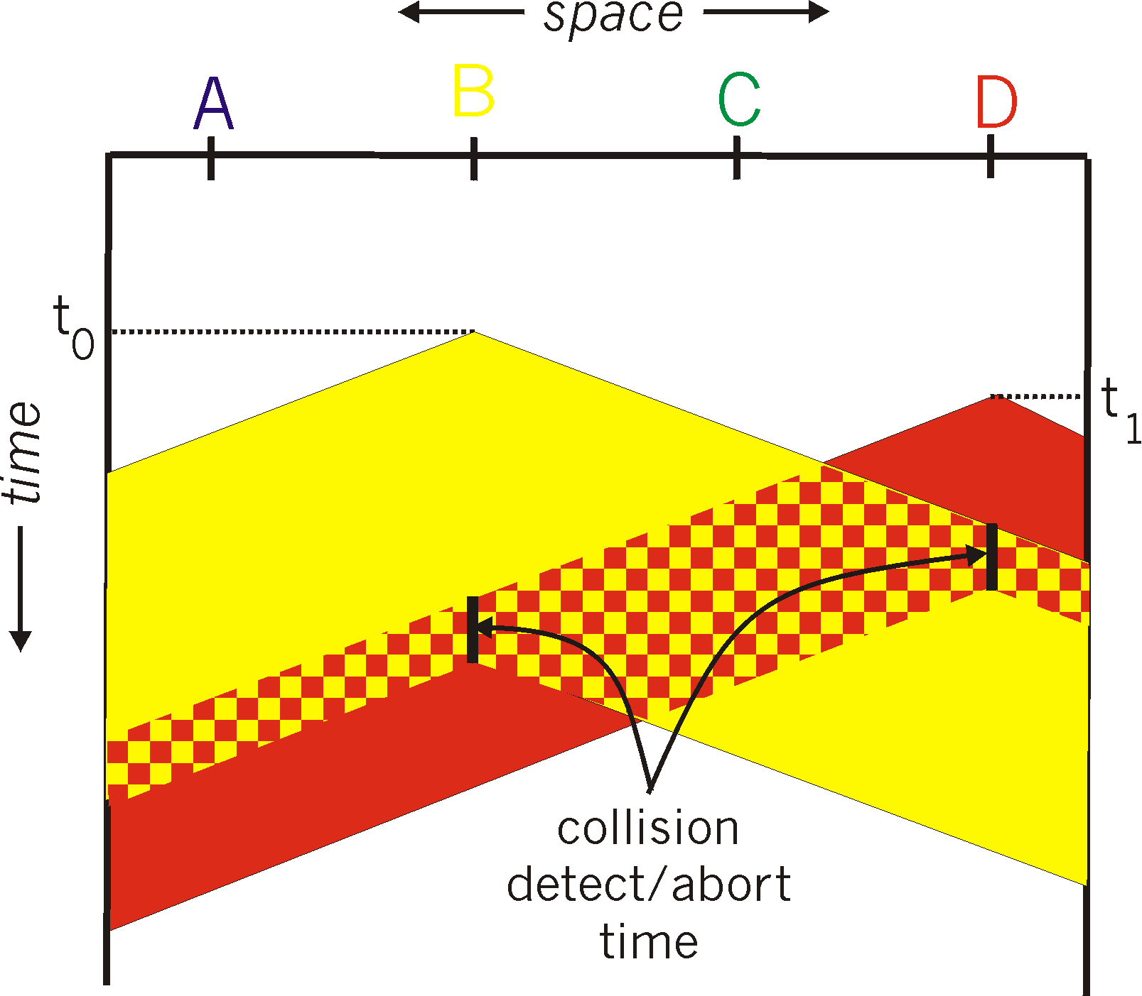
CSMA/CD (collision detection)
spatial layout of nodes

Slide 27
Ethernet CSMA/CD algorithm
1. NIC receives datagram from network layer, creates frame
2. If NIC senses channel idle, starts frame transmission. If NIC senses channel busy, waits until channel idle, then transmits.
3. If NIC transmits entire frame without detecting another transmission, NIC is done with frame !
4. If NIC detects another transmission while transmitting, aborts and sends jam signal
5. After aborting, NIC enters binary (exponential) backoff:
after mth collision, NIC chooses K at random from {0,1,2, …, 2^{m}-1}. NIC waits K·512 bit times, returns to Step 2
longer backoff interval with more collisions

Slide 28
Taking Turns Access Protocol: Token Passing
sender
Token determines node permitted to transmit.
Token passed from one node to another
recipient
Problems:
latency for hosts to send data
single point of failure (if token is lost, it has to be regenerated)
…

Slide 29
Taking Turns Access Protocol: Polling
master node “invites” slave nodes to transmit in turn
typically used with “dumb” slave devices.
Problems:
single point of failure (if primary device fails, no one can send)
latency for hosts to send data

Slide 30
Ethernet Frame Structure

Slide 31
Ethernet
Most widely used LAN network protocol.
wireless IEEE 802.11
wired IEEE 802.3
Implementations
10Base5: Thicknet
10Base2: Thinnet
100BaseT, 1000BaseT: Ethernet over UTP
1000BaseLX, 1000BaseSX: Ethernet over fiber
10GBaseSR, 10GBaseLR, … : Ethernet over fiber

Slide 32
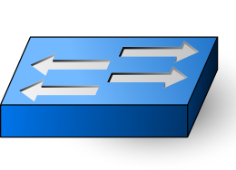
Ethernet Architecture
Bus Ethernet
listening host
sending host
listening host
listening host
listening host
Star Ethernet
Switch
listening host
sending host
listening host

Slide 33
Ethernet Frame Structure
Destination and Source address is 6 bytes long.
Adapter passes frame into memory if
destination address matches adapter’s destination address
destination address is broadcast address
Type in Ethernet Frame indicates higher layer protocol such as IP, Novell, AppleTalk, etc.
CRC checksum is used to detect error in frame, to discard frame.
Preamble
Dest. Addr.
Source Addr.
Data
CRC
Type

Slide 34
Ethernet Services
Connectionless: sender and receiver do not need to establish a connection prior to sending (hand-shake)
Unreliable: receiver does not sent an acknowledgment to sender.
Media Access:
CSMA/CD for wired
CSMA/CA for wireless
Collision Avoidance: The sender must signal intent to
transmit data before it is allowed to access channel and
transmit any data. All other stations may not transmit
until they signal their intent.

Slide 35
Address Resolution

Slide 36

LAN addresses and ARP
each adapter on LAN has unique LAN address
1A-2F-BB-76-09-AD
LAN
(wired or
wireless)
adapter
71-65-F7-2B-08-53
58-23-D7-FA-20-B0
0C-C4-11-6F-E3-98

Slide 37
LAN addresses (more)
MAC address allocation administered by IEEE
manufacturer buys portion of MAC address space (to assure uniqueness)
analogy:
MAC address: like Social Security Number
IP address: like postal address
MAC flat address ➜ portability
can move LAN card from one LAN to another
IP hierarchical address not portable
address depends on IP subnet to which node is attached

Slide 38


ARP: address resolution protocol
Question: how to determine
interface’s MAC address, knowing its IP address?
ARP table: each IP node (host, router) on LAN has table
IP/MAC address mappings for some LAN nodes:
< IP address; MAC address; TTL>
TTL (Time To Live): time after which address mapping will be forgotten (typically 20 min)
137.196.7.78
1A-2F-BB-76-09-AD
137.196.7.23
137.196.7.14
LAN
71-65-F7-2B-08-53
58-23-D7-FA-20-B0
0C-C4-11-6F-E3-98
137.196.7.88

Slide 39
ARP protocol: same LAN
A wants to send datagram to B
B’s MAC address not in A’s ARP table.
A broadcasts ARP query packet, containing B's IP address
dest MAC address = FF-FF-FF-FF-FF-FF
all nodes on LAN receive ARP query
B receives ARP packet, replies to A with its (B's) MAC address
frame sent to A’s MAC address (unicast)
A caches (saves) IP-to-MAC address pair in its ARP table until information becomes old (times out)
soft state: information that times out (goes away) unless refreshed
ARP is “plug-and-play”:
nodes create their ARP tables without intervention from net administrator

Slide 40
Addressing: routing to another LAN
walkthrough: send datagram from A to B via R
focus on addressing – at IP (datagram) and MAC layer (frame)
assume A knows B’s IP address
assume A knows IP address of first hop router, R (how?)
assume A knows R’s MAC address (how?)
A
B
R
111.111.111.111
222.222.222.222
74-29-9C-E8-FF-55
49-BD-D2-C7-56-2A
222.222.222.220
1A-23-F9-CD-06-9B
111.111.111.112
111.111.111.110
222.222.222.221
CC-49-DE-D0-AB-7D
E6-E9-00-17-BB-4B
88-B2-2F-54-1A-0F

Slide 41
Addressing: routing to another LAN
A creates IP datagram with IP source A, destination B
A creates link-layer frame with R's MAC address as dest, frame contains A-to-B IP datagram
MAC src: 74-29-9C-E8-FF-55
MAC dest: E6-E9-00-17-BB-4B
IP
Eth
Phy
IP src: 111.111.111.111
IP dest: 222.222.222.222
A
B
R
111.111.111.111
222.222.222.222
74-29-9C-E8-FF-55
49-BD-D2-C7-56-2A
222.222.222.220
1A-23-F9-CD-06-9B
111.111.111.112
111.111.111.110
222.222.222.221
CC-49-DE-D0-AB-7D
E6-E9-00-17-BB-4B
88-B2-2F-54-1A-0F

Slide 42
Addressing: routing to another LAN
frame sent from A to R
frame received at R, datagram removed, passed up to IP
MAC src: 74-29-9C-E8-FF-55
MAC dest: E6-E9-00-17-BB-4B
IP src: 111.111.111.111
IP dest: 222.222.222.222
IP
Eth
Phy
IP src: 111.111.111.111
IP dest: 222.222.222.222
IP
Eth
Phy
A
B
R
111.111.111.111
222.222.222.222
74-29-9C-E8-FF-55
49-BD-D2-C7-56-2A
222.222.222.220
1A-23-F9-CD-06-9B
111.111.111.112
111.111.111.110
222.222.222.221
CC-49-DE-D0-AB-7D
E6-E9-00-17-BB-4B
88-B2-2F-54-1A-0F

Slide 43
Addressing: routing to another LAN
R forwards datagram with IP source A, destination B
R creates link-layer frame with B's MAC address as dest, frame contains A-to-B IP datagram
MAC src: 1A-23-F9-CD-06-9B
MAC dest: 49-BD-D2-C7-56-2A
IP
Eth
Phy
IP
Eth
Phy
IP src: 111.111.111.111
IP dest: 222.222.222.222
A
B
R
111.111.111.111
222.222.222.222
74-29-9C-E8-FF-55
49-BD-D2-C7-56-2A
222.222.222.220
1A-23-F9-CD-06-9B
111.111.111.112
111.111.111.110
222.222.222.221
CC-49-DE-D0-AB-7D
E6-E9-00-17-BB-4B
88-B2-2F-54-1A-0F

Slide 44
Addressing: routing to another LAN
R forwards datagram with IP source A, destination B
R creates link-layer frame with B's MAC address as dest, frame contains A-to-B IP datagram
MAC src: 1A-23-F9-CD-06-9B
MAC dest: 49-BD-D2-C7-56-2A
IP
Eth
Phy
IP
Eth
Phy
IP src: 111.111.111.111
IP dest: 222.222.222.222
A
B
R
111.111.111.111
222.222.222.222
74-29-9C-E8-FF-55
49-BD-D2-C7-56-2A
222.222.222.220
1A-23-F9-CD-06-9B
111.111.111.112
111.111.111.110
222.222.222.221
CC-49-DE-D0-AB-7D
E6-E9-00-17-BB-4B
88-B2-2F-54-1A-0F

Slide 45
Addressing: routing to another LAN
R forwards datagram with IP source A, destination B
R creates link-layer frame with B's MAC address as dest, frame contains A-to-B IP datagram
MAC src: 1A-23-F9-CD-06-9B
MAC dest: 49-BD-D2-C7-56-2A
IP src: 111.111.111.111
IP dest: 222.222.222.222
IP
Eth
Phy
A
B
R
111.111.111.111
222.222.222.222
74-29-9C-E8-FF-55
49-BD-D2-C7-56-2A
222.222.222.220
1A-23-F9-CD-06-9B
111.111.111.112
111.111.111.110
222.222.222.221
CC-49-DE-D0-AB-7D
E6-E9-00-17-BB-4B
88-B2-2F-54-1A-0F

Slide 46
Data Transport Devices

Slide 47
Overview
Repeater
connects two segments
regenerates signal to enable data to be transmitted across combined single segment
operates at physical layer
Hubs
connects multiple host into a star configuration
operates at physical layer
Bridge
connects two LANs
directs frames between connected LANs to behave like a single LAN
operates at data link layer

Slide 48
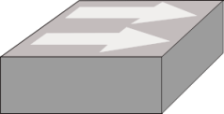
Data Transport in Hubs
Hub is a plug-and-play device.
requires no manual configuration
Frames sent across the network may collide with each other.
No frame buffering.
host B
host D
host C
Hub
segment
host A
When host A sends a frame to host B
no other host may send or a collision
will occur.

Slide 49
Data Transport in Switches
Switch is a plug-and-play, self-learning device.
requires no manual configuration
forwards Ethernet frames using physical address in the frame
identifies the destination port by observing traffic flow
host B
host D
host C
Switch
segment
host A
Host A and B and host C and D
can exchange messages without
interference.

Slide 50
Ethernet switch
link-layer device: takes an active role
store, forward Ethernet frames
examine incoming frame’s MAC address, selectively forward frame to one-or-more outgoing links when frame is to be forwarded on segment, uses CSMA/CD to access segment
transparent
hosts are unaware of presence of switches
plug-and-play, self-learning
switches do not need to be configured

Slide 51

Switch: multiple simultaneous transmissions
hosts have dedicated, direct connection to switch
switches buffer packets
Ethernet protocol used on each incoming link, but no collisions; full duplex
each link is its own collision domain
switching: A-to-A’ and B-to-B’ can transmit simultaneously, without collisions
A
C’
B
6
1
2
5
4
3
B’
C
A’
switch with six interfaces
(1,2,3,4,5,6)

Slide 52
Switch forwarding table
Q: how does switch know A’ reachable via interface 4, B’ reachable via interface 5?
A
C’
B
A: each switch has a switch table, each entry:
(MAC address of host, interface to reach host, time stamp)
looks like a routing table!
6
1
2
5
4
3
B’
C
A’
Q: how are entries created, maintained in switch table?
something like a routing protocol?
switch with six interfaces
(1,2,3,4,5,6)

Slide 53
Switch: self-learning
Source: A
Dest: A’
switch learns which hosts can be reached through which interfaces
when frame received, switch “learns” location of sender: incoming LAN segment
records sender/location pair in switch table
A
A A’
C’
B
6
1
2
5
4
3
B’
C
A’
MAC addr interface TTL
A
1
60
Switch table
(initially empty)

Slide 54
Switch: frame filtering/forwarding
when frame received at switch:
1. record incoming link, MAC address of sending host
2. index switch table using MAC destination address
3. if entry found for destination then {
if destination on segment from which frame arrived then drop frame
else forward frame on interface indicated by entry
}
else flood /* forward on all interfaces except arriving
interface */

Slide 55
Self-learning, forwarding: example
Source: A
Dest: A’
A
A A’
frame destination, A’, locaton unknown:
flood
C’
B
destination A location known:
6
1
2
A A’
A A’
A A’
A A’
selectively send
on just one link
A A’
5
4
3
B’
C
A’ A
A’
MAC addr interface TTL
A
1
60
switch table
(initially empty)
A’
4
60

Slide 56

Interconnecting switches
switches can be connected together
S₄
S₁
S₃
A
S₂
F
I
B
C
D
E
G
H
Q: sending from A to G - how does S₁ know to forward frame destined to F via S₄ and S₃?
A: self learning! (works exactly the same as in single-switch case!)

